Slide 1
Trivia Showdown
A Real-Time Multiplayer Trivia Challenge
Presented by: Divyanshi Verma
205124031

Slide 2
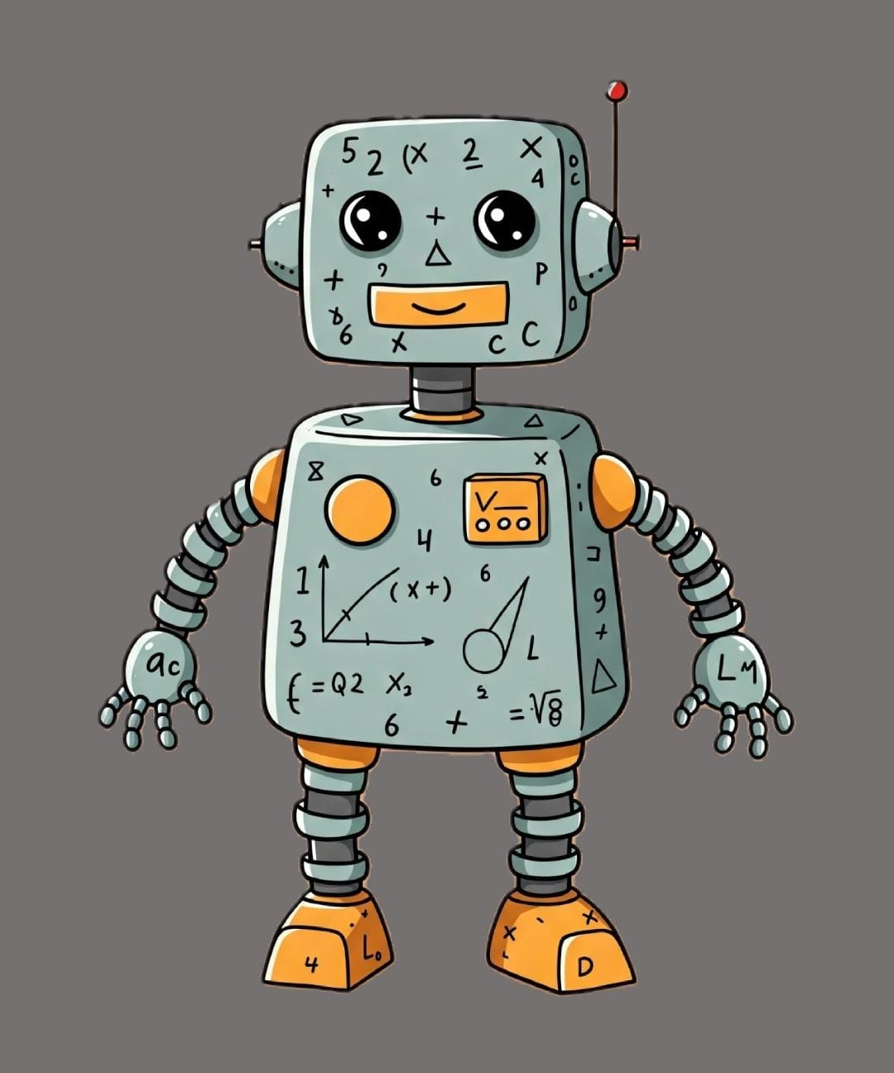
Problem Statement:Trivia Showdown
What is Trivia Showdown?
A fast-paced multiplayer trivia game.
Players compete in real-time to answer questions.
Focused on speed, accuracy, and survival.

Slide 3
Key Features:
Real-time gameplay using Socket.IO.
30-second timer per question.
Dynamic leaderboard with live updates.
Players get 3 lives – lose a life for each wrong answer.
For Winner:
  Last player standing wins the game.
  If multiple players survived then the player with highest score wins the game.
  If players have same highest score, then no player will be declared as winner.

Slide 4
How It Works:
Players join a room with a unique game code.
Game starts when 2 or more players are present.
All players receive the same question at the same time.
Players has to answer before the time runs out.
Each correct answer will give you points.
Each Wrong answer will cost a life.
When only 1 player remains, they’re declared the winner.
If multiple players survived then the player with highest score wins the game.
If players have same highest score, then no player will be declared as winner.

Slide 5
Tech Stack:
Frontend: HTML, CSS, JavaScript
Backend: Node.js, Express.js
Real-Time Engine: Socket.IO
Data: JSON-based question bank

Slide 6
Why It’s Exciting:
Combines the thrill of competition with knowledge.
Fun for groups, and online events.
Encourages quick thinking and learning.
Easy to expand with new question sets or themes.

Slide 7
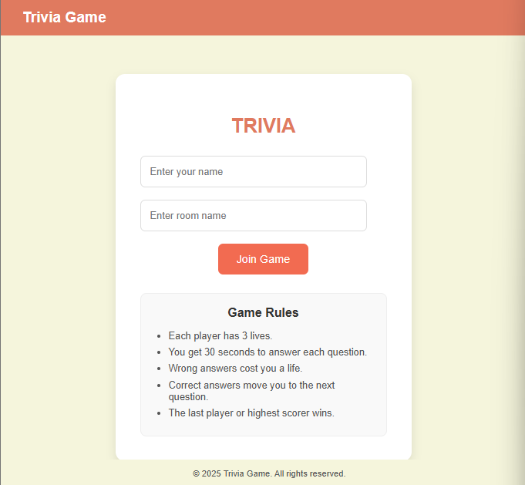

Sample Output:
Snapshots of application Functionalities:
Initial State:

Slide 8
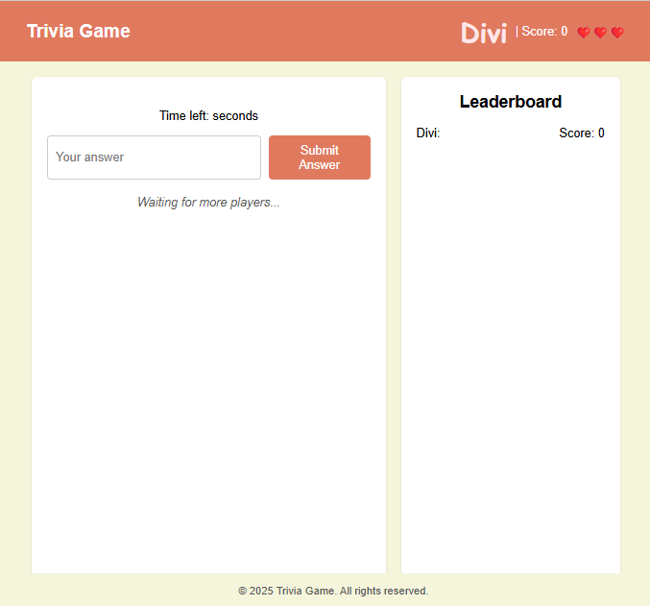
Sample Output:
A player joined a game:

Slide 9
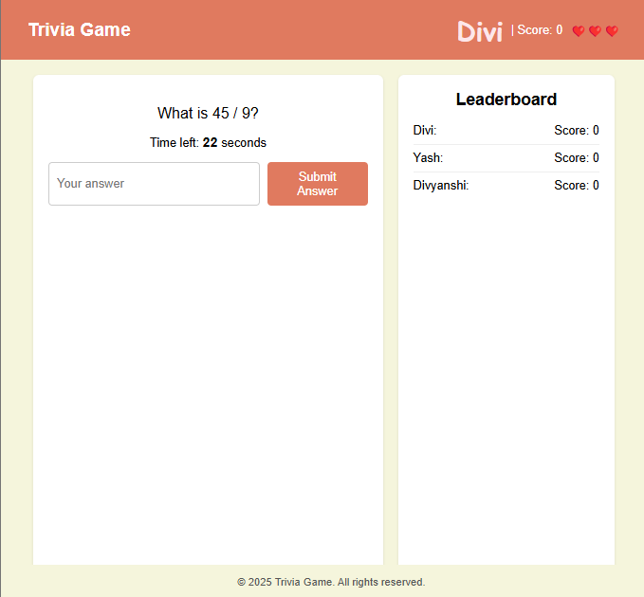
Sample Output:
Multiple players joined a game:

Slide 10
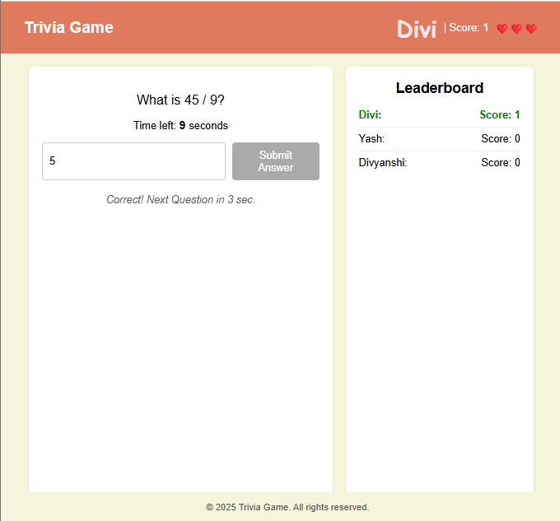
Sample Output:
Player given a correct answer:

Slide 11
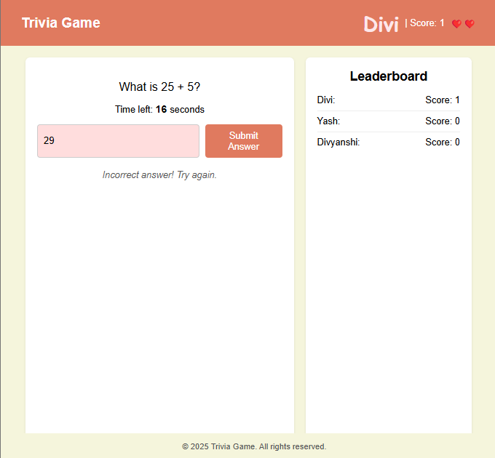
Sample Output:
Player given a wrong answer:

Slide 12
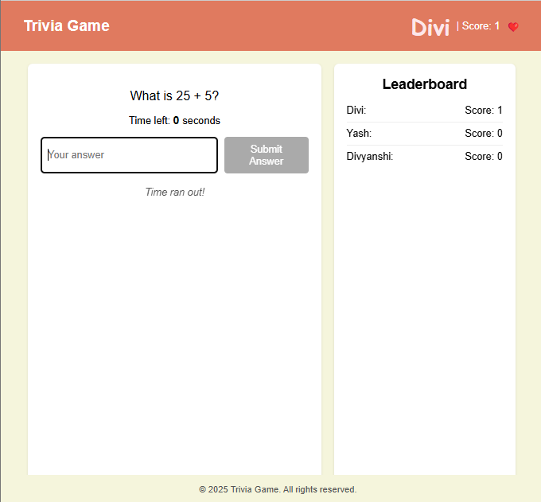
Sample Output:
Unable to give answer within time limit:

Slide 13
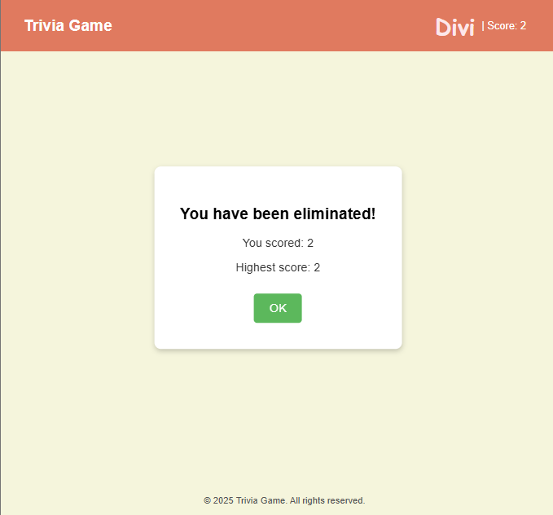
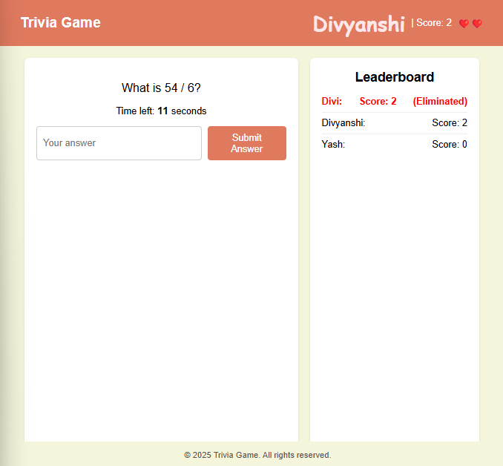
Sample Output:
Player is eliminated, all 3 life are exhausted:

Slide 14
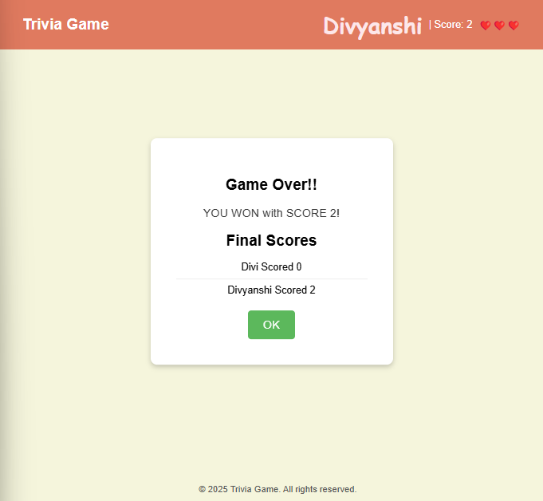
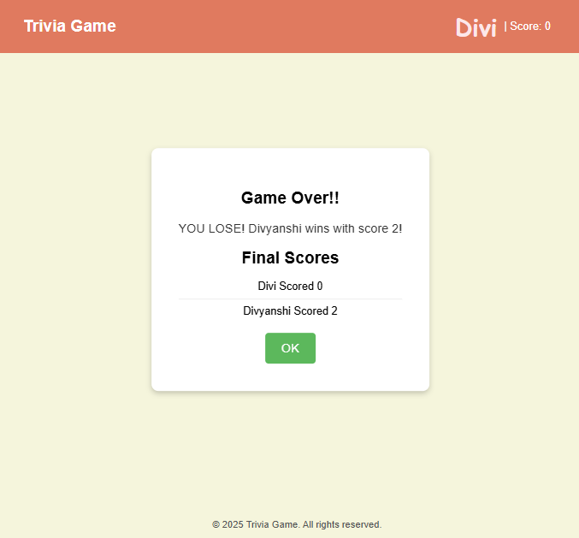
Sample Output:
Any of the player wins, Game over:

Slide 15
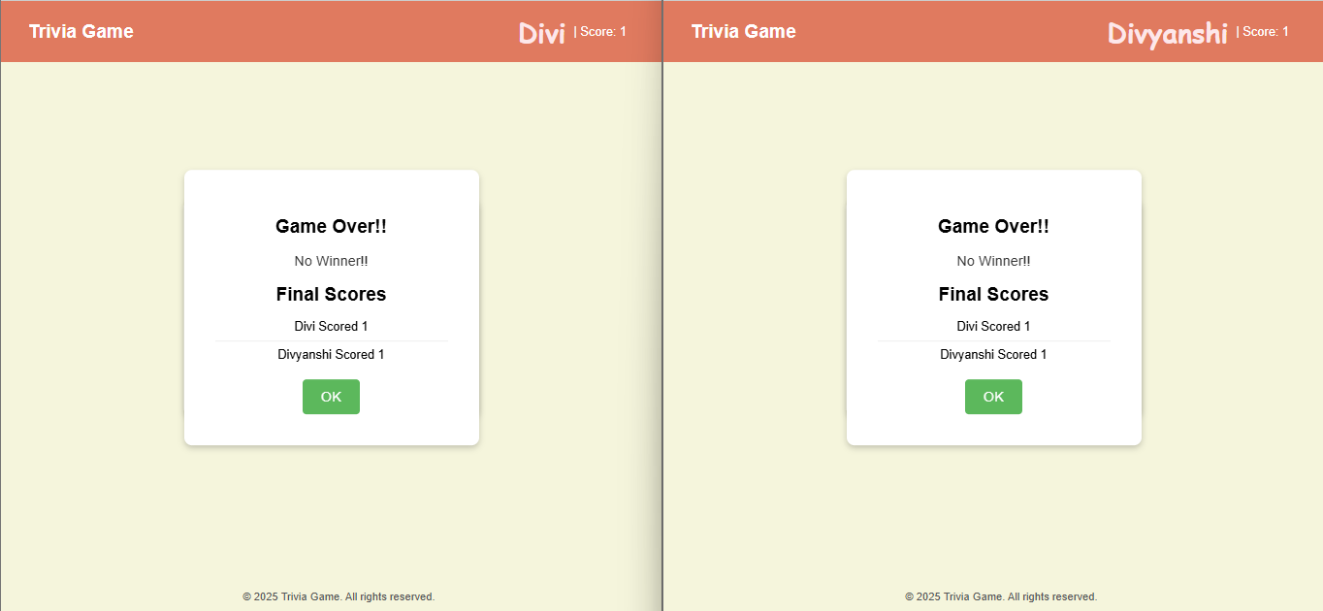
Sample Output:
None of the player wins, Game over:

Slide 16
Thankyou !!

